Slide 1
I Am New

Slide 2
Note: After you download the slideshow, you may also need to download some videos from YouTube & add them into this PowerPoint. This tool can help you: Free YouTube Download
We present these messages in outdoor venues using the SonShineTent. Watch the video of our service that goes with this message, click here: http://campaignkerusso.org/?p=15367
We would love to know more about the people who download our lessons & sermons. We invite you to email us & let us know where & how you use them.
info@campaignkerusso.org

Slide 3
Welcome All

Slide 4
Let’s Begin with Prayer

Slide 5
I Am New

Slide 6
Song: He’s Still Working on Me
Video Goes Here Title: He’s Still Working on Me Download Here:
https://youtu.be/qeOU3jspOfk

Slide 7
He’s Still Working on in Me

Slide 8
Everybody has DNA
DNA is the tiny part of the human cell that contains all the information needed to make a person, a person.
In the flesh, we are what is written in our DNA.

Slide 9
Science is quickly learning to alter DNA by first snipping it…

Slide 10
…and then, replacing undesirable traits with more desirable ones.

Slide 11
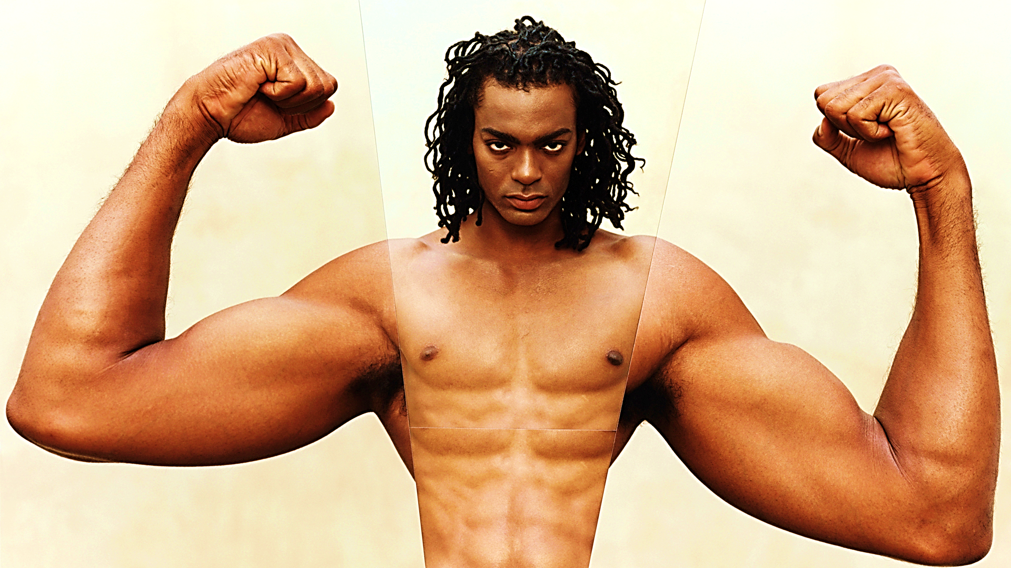
Many people want to re-create themselves at a DNA level.
But, they cannot change their inner man at the spiritual level.

Slide 12
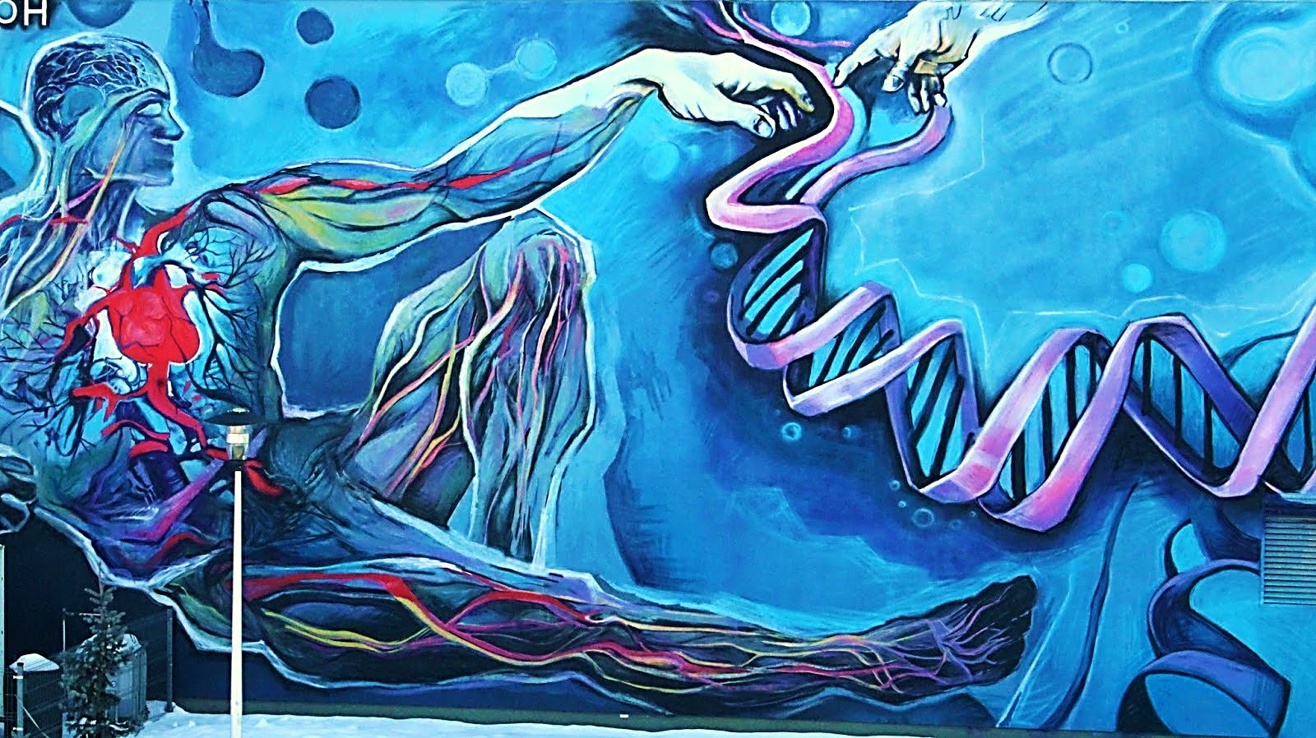
Only God (the Creator) can replace our inner man “DNA.”
First, we were born in the image of sinful Adam, and then, born-again in the image of the Holy and Righteous Jesus Christ.

Slide 13
“When someone becomes a Christian, he becomes a brand-new person inside. He is not the same anymore. A new life has begun!” 2 Cor. 5:17 TLB

Slide 14
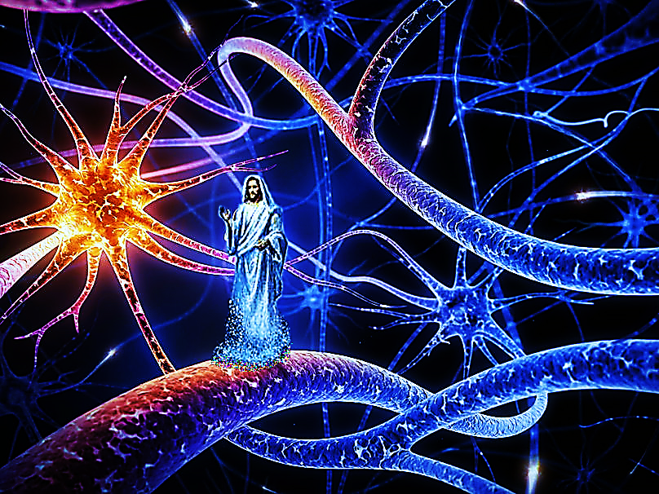
“…Christ in you, the hope of glory.” Col. 1:27 KJV

Slide 15
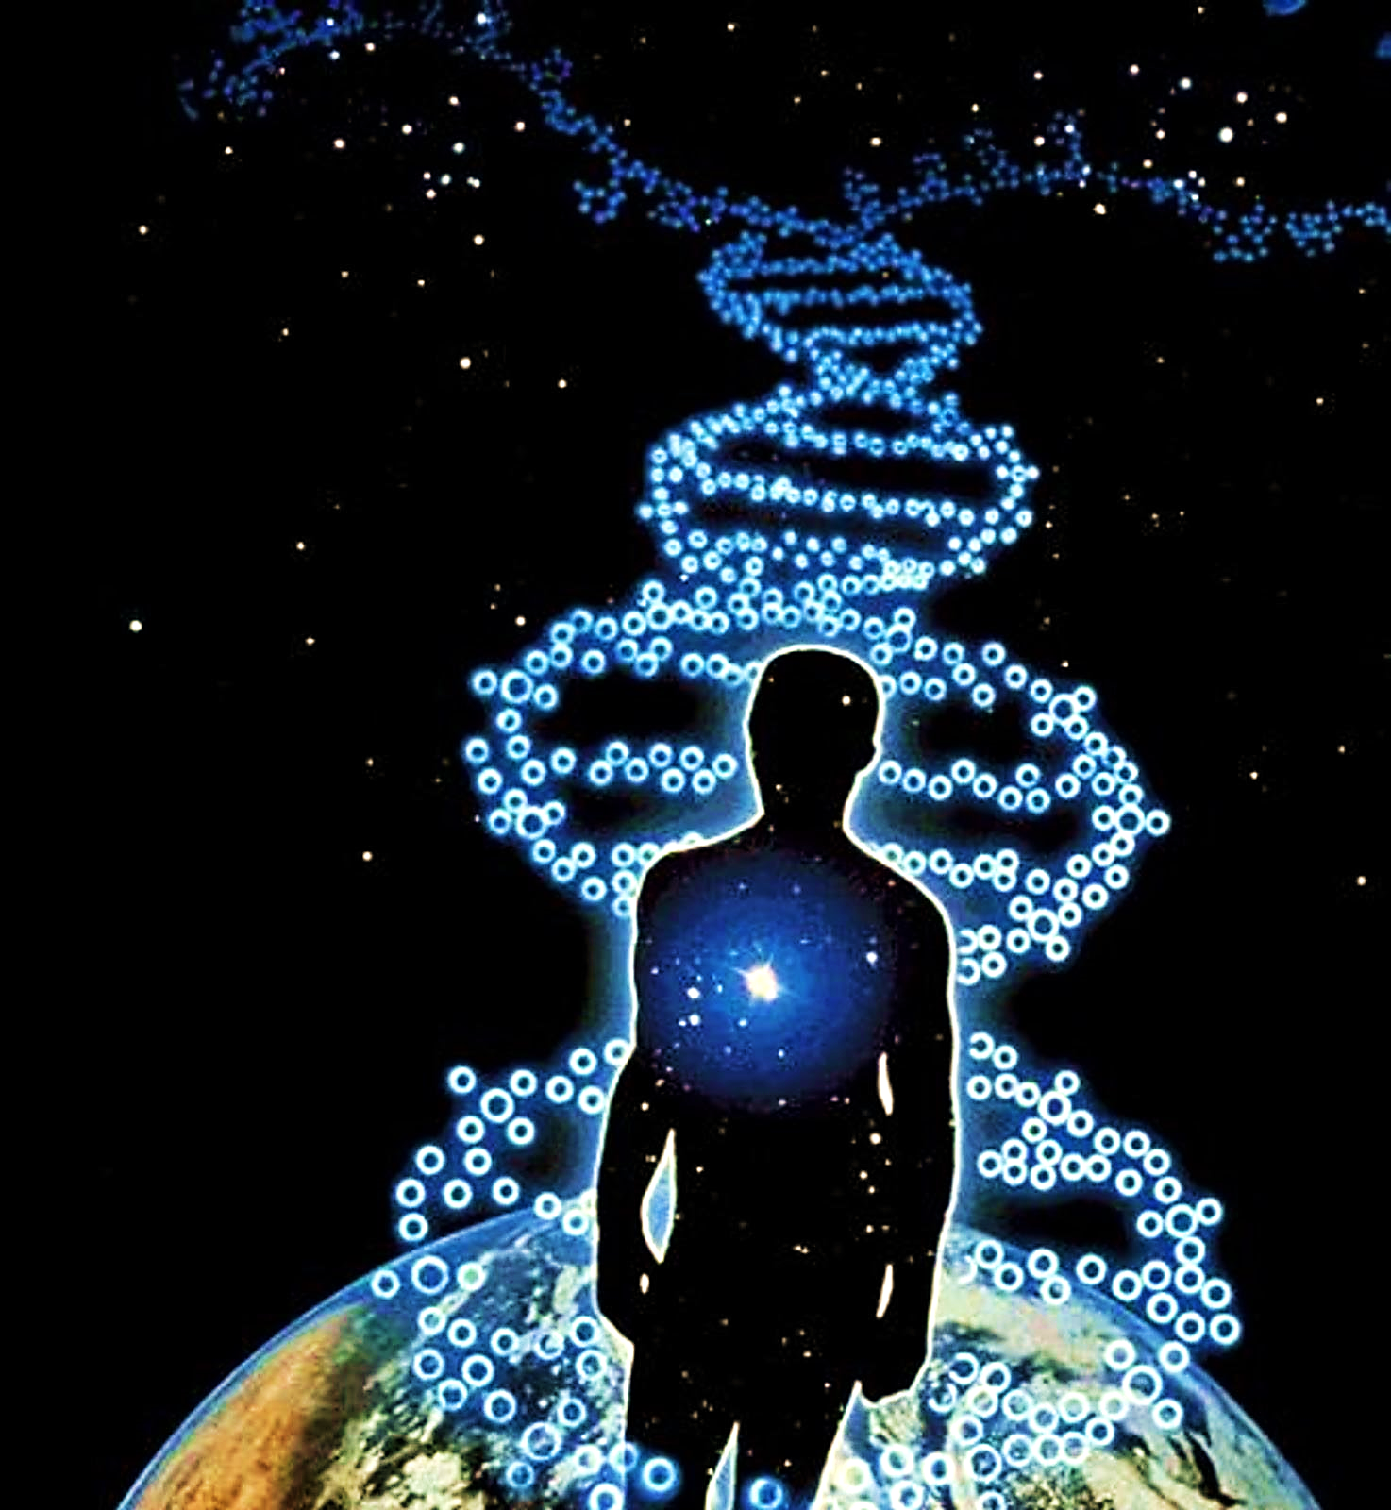
“…that He may grant you according to the riches of His glory to be strengthened with power through His Spirit in the inner person”
Eph.3:16 LEB

Slide 16
“Let this mind be in you, which was also in Christ Jesus.”
Phil. 2:5 KJV

Slide 17
The Holy Spirit and the Word of God work together.
“And be renewed in the spirit of your mind”
Eph. 4:23 KJV
Unlike human growth, mere passage of time won’t cause the Christ nature to grow, but loving & embracing the wonderful Word of God will.

Slide 18
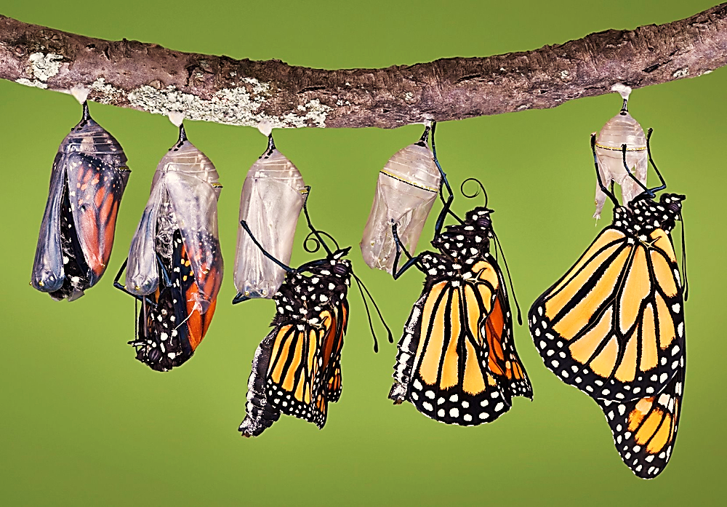
“…being transformed into the same image from glory to glory by the Spirit of the Lord.” 2 Cor. 3:18 MEV

Slide 19
God asks us to bring the Christ nature out for the world to see.
“…clothe yourselves with the new nature, which was created according to God’s image in righteousness and true holiness.” Eph. 4:24 ISV

Slide 20
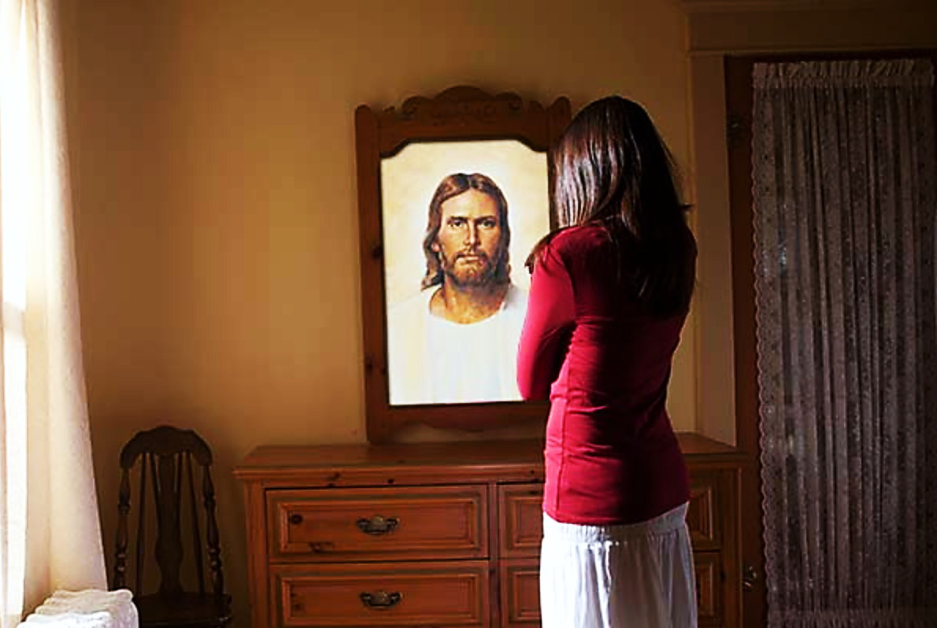
So, What Does the Christ Nature Look Like?

Slide 21
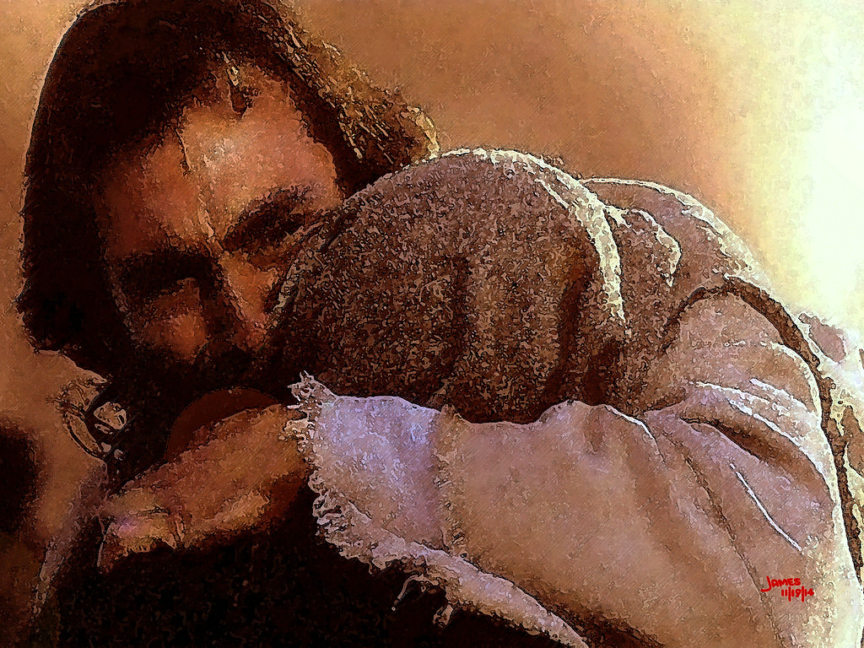
The Christ Nature Loves till it Hurts

Slide 22
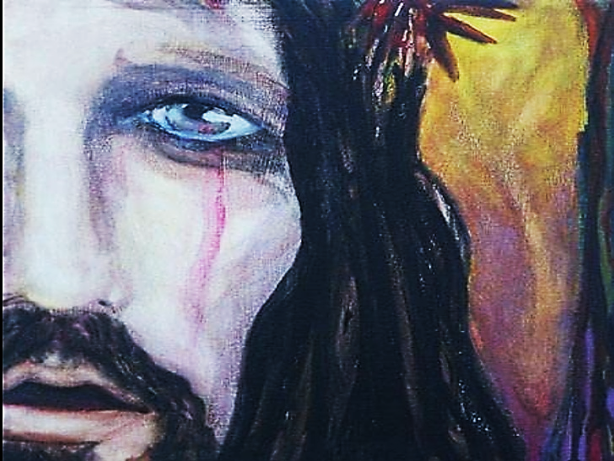
Jesus was Brokenhearted for Unbelievers
“When Jesus saw that Mary and the people with her were crying, he was terribly upset…Jesus started crying.” Jn 33, 35 CEV

Slide 23
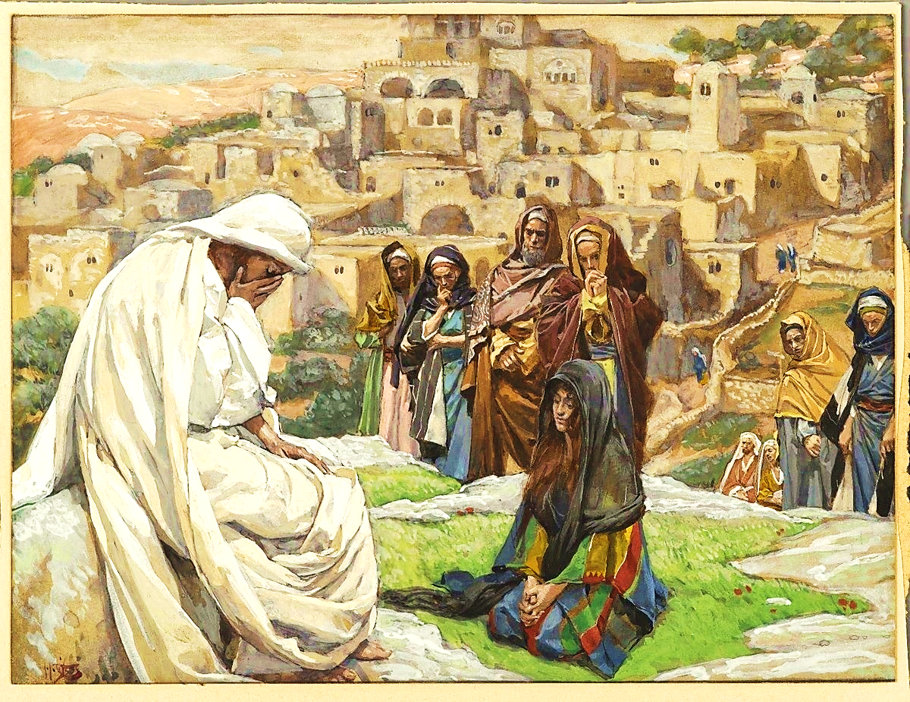
It Was Painful to Love Israel
“Jerusalem, Jerusalem, you who kill the prophets and stone those who were sent to you!
How often I have wanted to gather your people just as a hen gathers her chicks under her wings. But you didn’t want that.” Luke 13:34 CEB

Slide 24
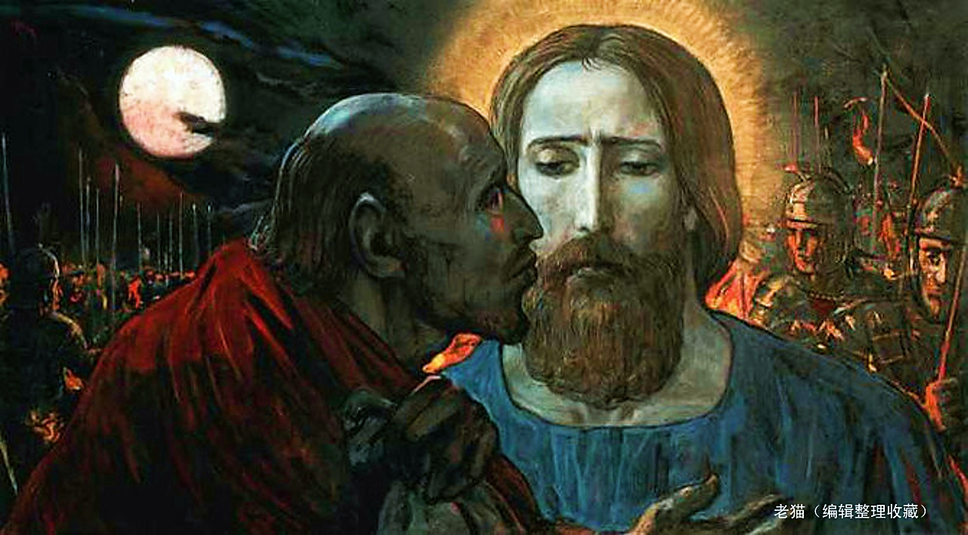
It Was Painful to Love Judas
“Jesus looked at him with sorrow and said, “A kiss, Judas? Are you really going to betray the Son of Man with a kiss?” Lk. 22:48 TPT

Slide 25
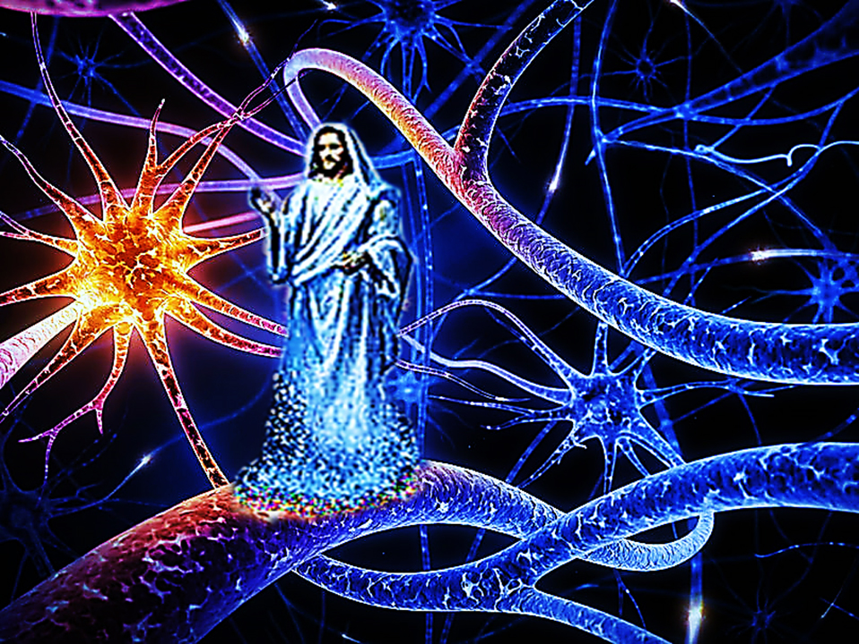
This Same Jesus is in the Believer’s Inner Man & He’s Growing

Slide 26
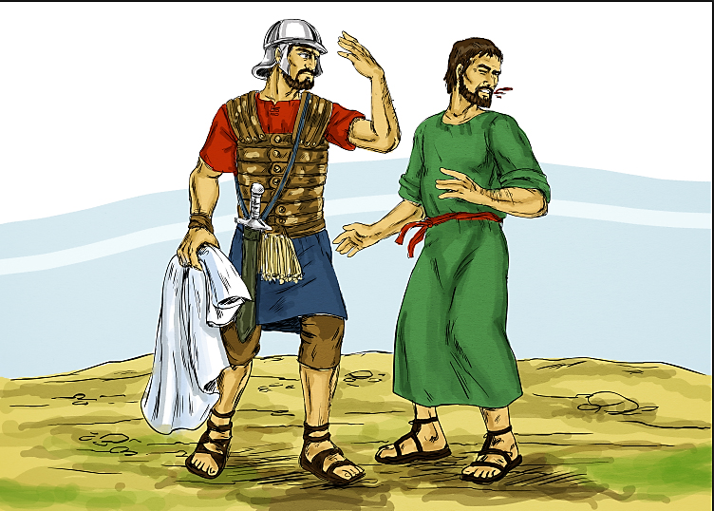
We Can Love Our Enemies
“But I tell you, do not resist an evildoer. But whoever slaps you on your right cheek, turn to him also the other.” Mat. 9:39 TLV

Slide 27
What Else Does the Christ Nature Look Like?

Slide 28
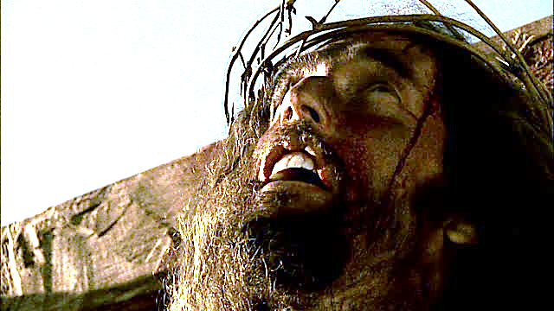
The Christ Nature Gives till
There’s no More to Give

Slide 29
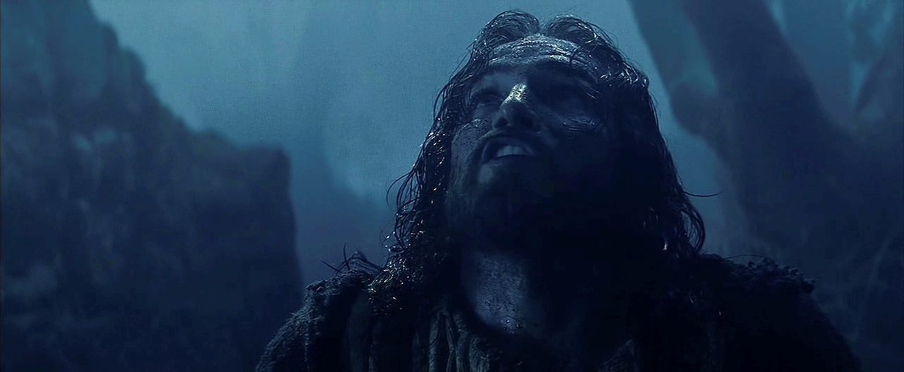
“I am too deeply troubled now to know how to express my feelings. Should I say, ‘Father, save me from this time of suffering’? No! I came for this time of suffering.” Jn. 12:27

Slide 30
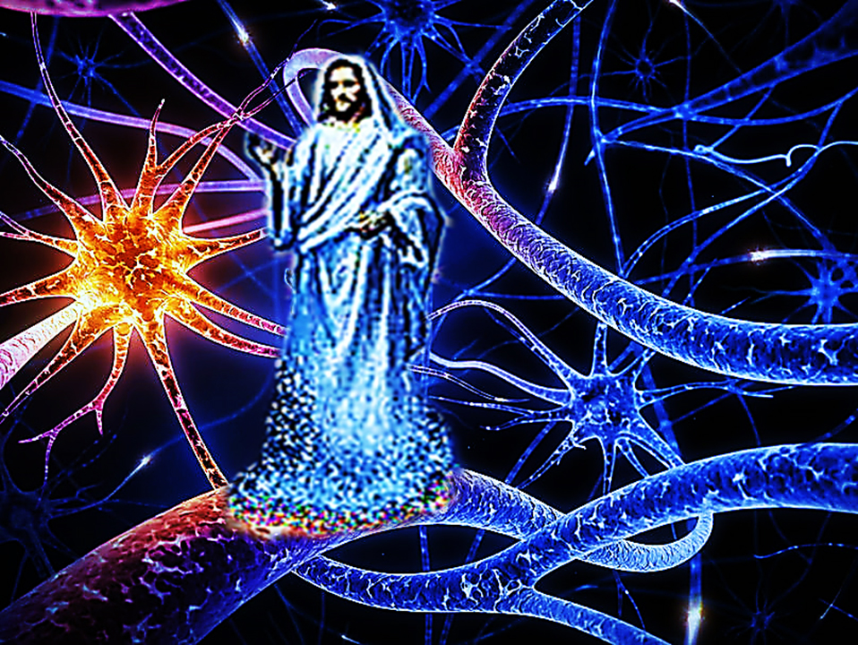
This Same Jesus is in the Believer’s Inner Man & He’s Growing

Slide 31
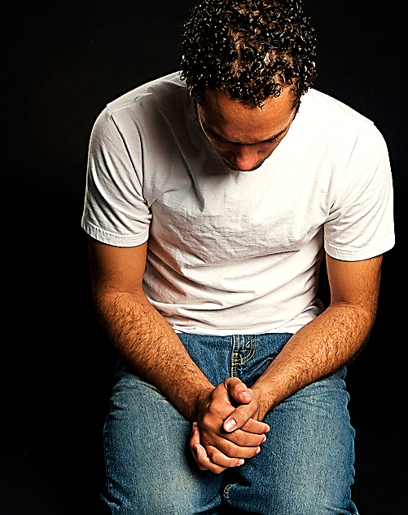
“And so, dear brothers, I plead with you to give your bodies to God. Let them be a living sacrifice, holy—the kind He can accept.
When you think of what He has done for you, is this too much to ask?”
Rom. 12:1 TLB
We Are Also Called to a Life of Sacrifice

Slide 32
What Else Does the Christ Nature Look Like?

Slide 33
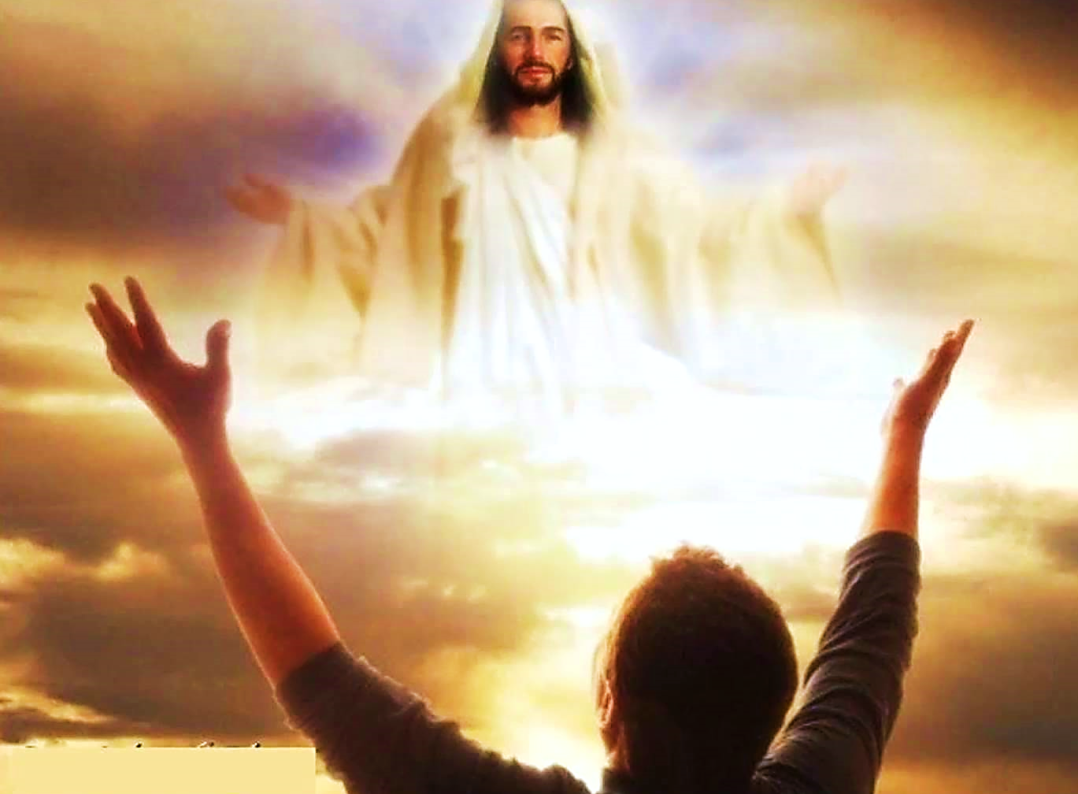
The Christ Nature Lives and it Births

Slide 34
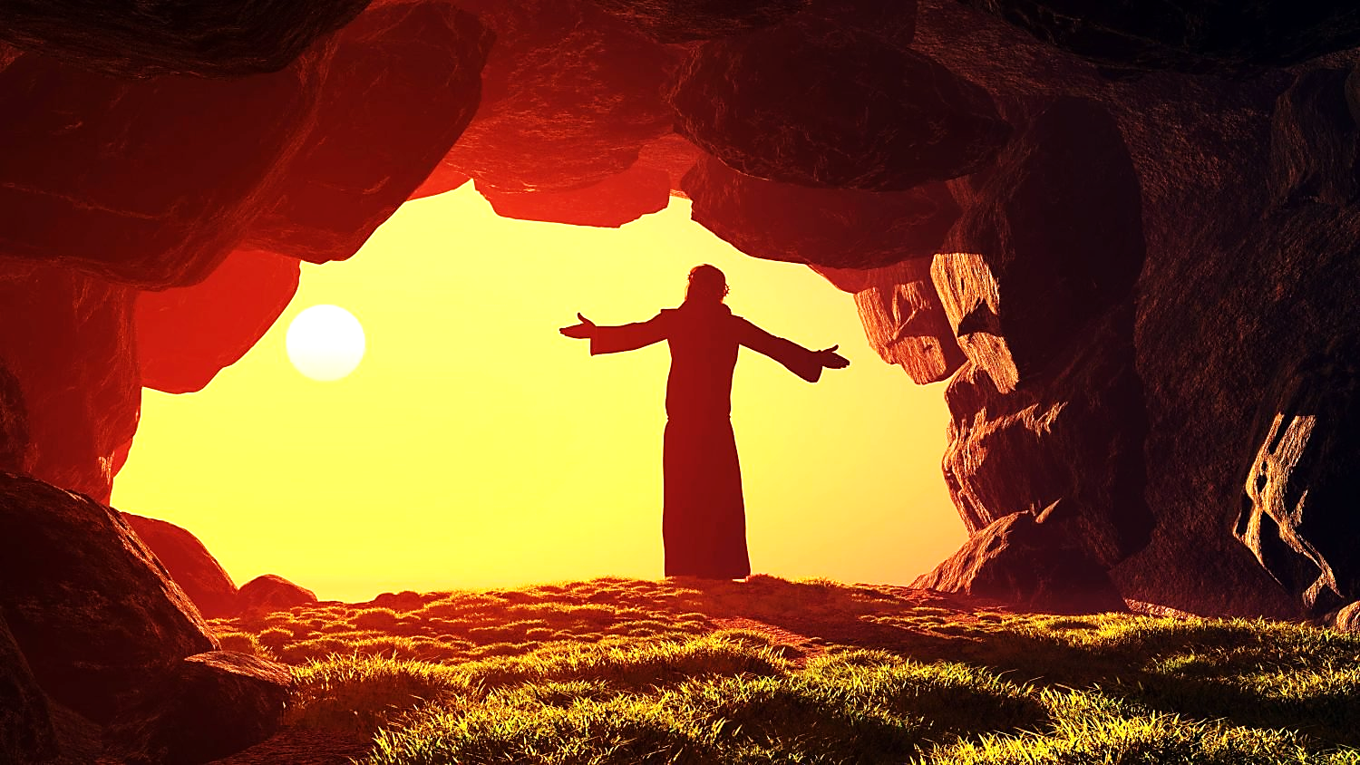
He…
Won’t die!
Can’t die!
Won’t give up!
Cannot be squelched!

Slide 35
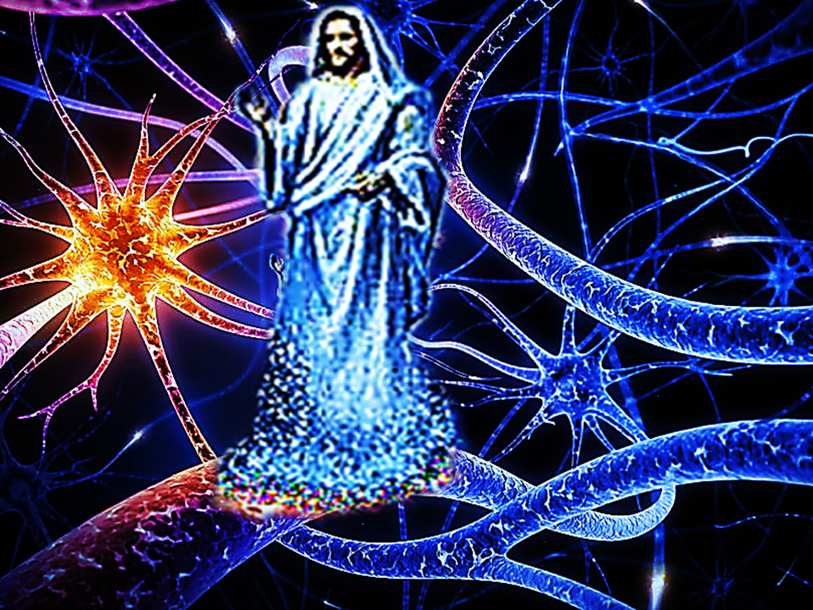
This Same Jesus is in the Believer’s Inner Man & He’s Growing

Slide 36
A righteous person may fall seven times, but he gets up again. However, in a disaster, wicked people fall.
Pv. 24:16 GW
Many are the afflictions of the righteous, But the LORD delivers him out of them all. Ps. 34:19 KJV

Slide 37
The Christ Nature Lives and it Births

Slide 38
We Rose When He Rose
So if you have been raised with Christ, seek the things above, where Christ is, seated at the right hand of God. Col. CSB

Slide 39
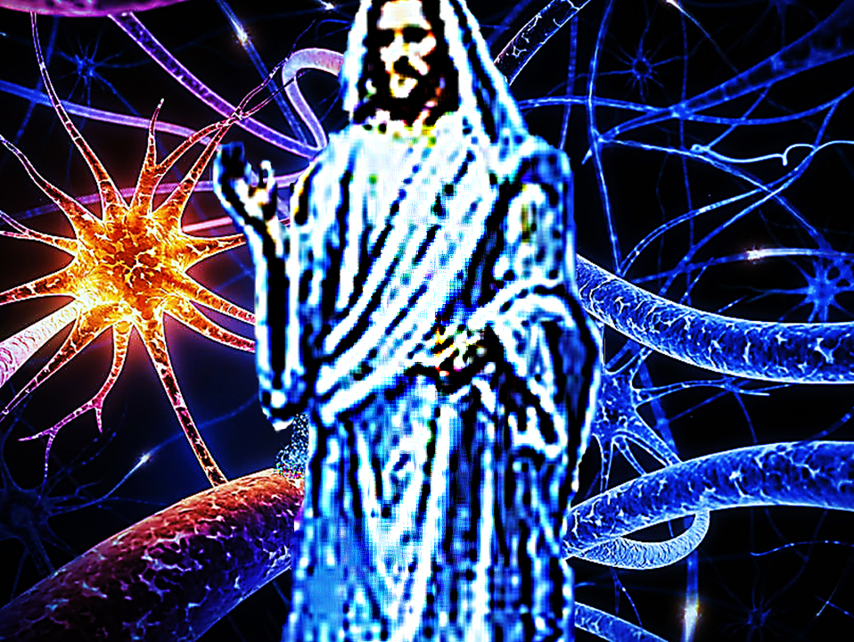
This Same Jesus is in the Believer’s Inner Man & He’s Growing

Slide 40
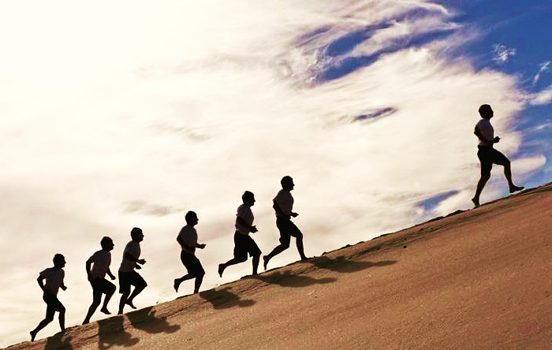
Others Rise as We Rise
“In all things show them how to live by your life...” Titus 2:7 NLV
Our personal resurrections inspire others.

Slide 41
Also, our resurrection
joy revives others.
They can rise with us.

Slide 42
“When someone becomes a Christian, he becomes a brand-new person inside. He is not the same anymore. A new life has begun!” 2 Cor. 5:17 TLB

Slide 43
“My dear brothers, we are God's children now. No one knows yet what we shall be like.
But we know that when Jesus comes, we will be like him. We will see him as he really is.” 1 Jn. 3:2 WE

Slide 44
Song: I AM New
Video Goes Here Title: I Am New Download Here:
https://youtu.be/u9bjPwwLgj0

Slide 45
Is Jesus
Speaking to You?
“They said to each other, ‘Did not our hearts burn within us while he talked to us on the road, while he opened to us the Scriptures?’”
John Wesley Said:
“…the preacher was describing the change which God works in the heart through faith in Christ and I felt my heart strangely warmed.”
Jesus makes His presence Known by a small voice!

Slide 47
What is the Sinner‘s Prayer?
This is a prayer we can pray when we are ready to admit we are sinners and need Christ’s forgiveness.
It must be prayed with faith in our hearts and a readiness to have a life-changing encounter with Jesus Christ.

Slide 48
A prayer of faith → Pray this prayer if :
If you never have before
You have in the past, but you think it would mean more today
You have been walking afar off and you want to come back
You want to set an example & show others how it is done
You just like to give your heart to Jesus again & again
Faith

Slide 49
We Declare Our Faith Publicly Because Jesus Declared His LOVE Publicly
“If you stand before others and are willing to say you believe in me, then I will tell my Father in heaven that you belong to me.” Mat 10:32
If you are ready to give your heart & life to Jesus right now, please come to the front as we pray this prayer together.

Slide 50
Three Important Questions
Do you want to know Jesus as your Savior right now?
Do you believe He died to save you from your sins & that He rose from the dead?
Do you believe that He is here, waiting to save you right now?

Slide 51
The Prayer of a Sinner Turning to Jesus
Dear Jesus, I know that I have sinned against You and that my sins separate me from You.
I am truly sorry.
Right now, I turn away from my sinful past .
Please forgive me, and help me to keep from sin.
I believe You died for my sins.
I Believe You rose from the dead, you are alive, and you hear this prayer from my heart.
I invite You Jesus to be both my Savior and the Lord of my life.
I want You to rule my life from now on.

Slide 52
“But some people did accept him. They believed in him, and he gave them the right to become children of God.”
John 1:12

Slide 54
“If you openly say, ‘Jesus is Lord’ and believe in your heart that God raised him from death, you will be saved.”
Rom. 10:9
What did you learn today?
What about being new in Christ?
What have you been thinking about God lately?
What do you want to tell others about Jesus?

Slide 55
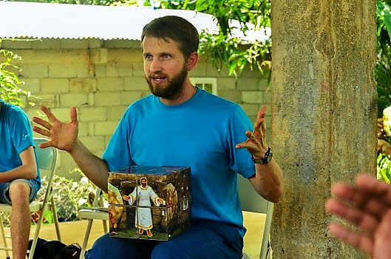
Evangecube
ss

Slide 56
Evangecube
ss
This Evangelism Tool is Available Here:
Standard Size EvangeCube
Evangecube Big Cube (assembled)

Slide 57
Let’s Close in Prayer

Slide 58
Note: After you download the slideshow, you may also need to download some videos from YouTube & add them into this PowerPoint. This tool can help you: Free YouTube Download
We present these messages in outdoor venues using the SonShineTent. Watch the video of our service that goes with this message, click here: http://campaignkerusso.org/?p=15367
We would love to know more about the people who download our lessons & sermons. We invite you to email us & let us know where & how you use them.
info@campaignkerusso.org

